Slide 1



Project Review
Detecting and Determining Degree of Suicidal Ideation on Tweets Using LSTM and Machine Learning Models
Student Members:
Shruti V.V(310619104132)
Shriraaman S(310619104130)
Vasanth G(310619104159)
Supervisor:
Dr. Deepa.J
Assistant Professor

Slide 2
Introduction
Suicide is a public health problem since there are 8,00,000 suicide deaths each year worldwide.
SI is commonly referred to as having a wish to die, thinking about dying, or making plans to commit suicide. However, because they are not frequently and openly articulated, these ideas are hard to identify and quantify.
On social media platforms like Twitter, Reddit, or Instagram, psychological anguish relating to subjectively perceived stressful life events and conditions that may support suicidal ideation and suicide is being shared more frequently .
Suicide rates have been linked to the percentage of Twitter users who posted messages that include risk factors for suicide.

Slide 3
Objective(s)
The objective of this project is to find the severity of the Suicidal Ideation from Twitter users using a combination of user profile and linguistic features.

Slide 4
Motivation
One of the possible approaches to preventing suicide effectively is early detection of suicidal ideation.
There is a concerning tendency that potential suicide victims post their suicidal thoughts on social websites like Facebook, Twitter, Reddit, and MySpace.
It can provide early warnings for the online users automatically when integrated into the online websites.

Slide 5
Literature Survey
Author name | Title of the paper | Journal name/scopus/Year | Concept
Moumita Chatterjee et al | “Suicide ideation detection from online social media: A multi-modal feature based technique.” | International Journal of Information Management Data Insights 2, no. 2 (2022) | The data set was used to extract a number of features, including linguistic, topical, sentimental, personality, TF-IDF, and temporal ones.
Adonias C. de Oliveiraa et al | "How can machine learning identify suicidal ideation from user's texts? Towards the explanation of the Boamente system." | Procedia Computer Science 206 (2022) | This study focused on three best ML-based algorithms-Extra Trees, Random Forest, and C-Support Vector Machine.
Katchapakirin et al | "How can machine learning identify suicidal ideation from user's texts? Towards the explanation of the Boamente system." | 2018 15th international joint conference on computer science and software engineering (jcsse), pp. 1-6. IEEE, (2018). | NLP methodologies and ML models were used to detect SI from the facebook datasets of Thai community.

Slide 6
Literature Survey
Author name | Title of the paper | Journal name/scopus/Year | Concept
Shini Renjith et al, | , “An ensemble deep learning technique for detecting suicidal ideation from posts in social media platforms.” | Journal of King Saud University-Computer and Information Sciences 34, no. 10 (2022). | The study introduced a LSTM-Attention-CNN model to detect SI from social media
Damien Lekkas et al | “Predicting acute suicidal ideation on Instagram using ensemble machine learning models.” | Internet Interventions 25 (2021). | Ensemble ML methodologies were used to predict acute SI from Instagram dataset.
Farsheed Haque et al | "A Transformer Based Approach To Detect Suicidal Ideation Using Pre-Trained Language Models." | 2020 23rd international conference on computer and information technology (ICCIT), pp. 1-5. IEEE, (2020). | In this study transformer models were found to perform better than deep learning models to analyze raw posts and detect SI
Faisal Muhammad Shah et al | , "A Hybridized Feature Extraction Approach To Suicidal Ideation Detection From Social Media Post." | 2020 IEEE Region 10 Symposium (TENSYMP), pp. 985-988. IEEE, (2020). | The study mainly focussed on the feature selection and best feature extraction methods for the better accuracy of the classification models.

Slide 7
Issues in Existing system
•From both a psychological and a clinical perspective,collecting data and/or patients is typically expensive, and online data may help in reducing cost and understanding thoughts and behaviours.
•The existing system is mostly binary ,i.e suicidal or non suicidal,it doesn’t take the whole spectrum into consideration.
•It doesn’t aid against a wide range of self destructive behaviors like self harm, ED etc.
•Simple feature sets and classiﬁcation models are not predictive enough to detect suicidal tendencies.

Slide 8
Proposed System
The proposed system uses twitter as a tool to examine the mental state of the users.
The system does Sentiment Analysis of tweets and employs data preparation, feature extraction, analysis, fusion, classification using LSTM and ML models to find Suicidal Ideation in a profile.
The aim is to improve the results of the suicidal profiles detection by determining more precisely their degree of suicidality.
The vast spectrum of risk is taken into consideration instead of just marking a profile as suicidal or non-suicidal.
A degree is assigned to the profile and according to which future decisions can be made.

Slide 9
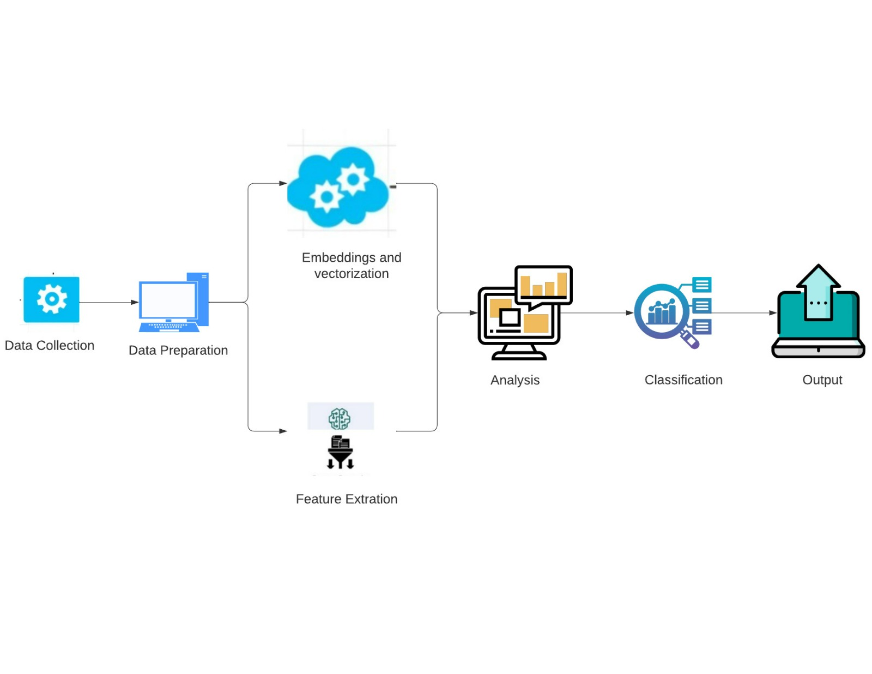
Architecture Diagram

Slide 10
List of modules
1.Module 1:
Data collection
Data preprocessing
2.Module 2:
Splitting dataset
Feature extraction
3.Module 3:
Building model
Determining the degree

Slide 11
Module I - Data collection and preprocessing
Input - dataset was collected from twitter using TWEEPY and then preprocessed.
Output- Preprocessed tweets from twitter.
Description :
1. A simple set of statistics were collected about their profile as well as their tweets (5988 tweets from 329 users)
2.In data preprocessing URL links present in user posts ,stop words like ’a’, ’an’, ’the’, etc and non-ASCII characters were removed.Stemming and POS tagging were also performed.

Slide 12
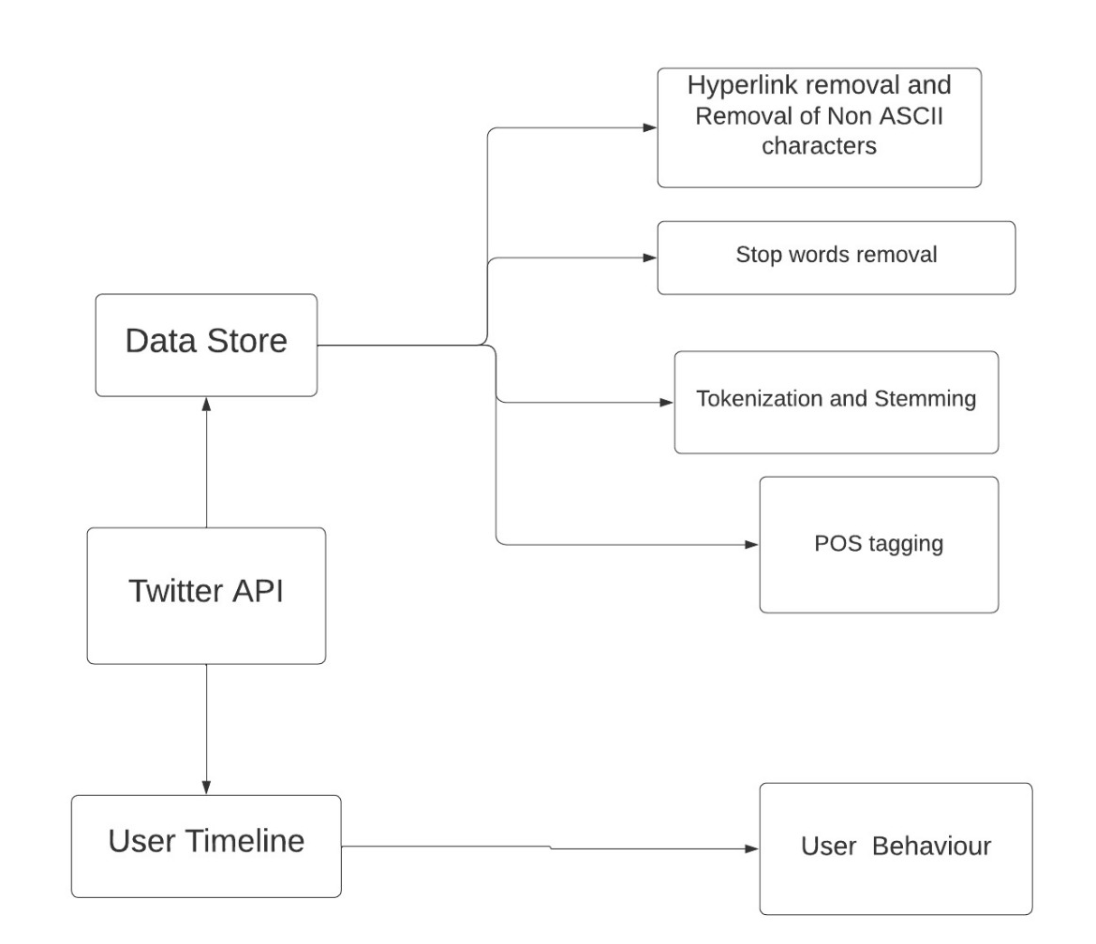
Functional Architecture of Module I

Slide 13
Module II - Feature Extraction
Input:fully preprocessed tweets
Output:feature vectors for the model
Description: The preprocessed tweets undergo tokenization,vectorization,padding and embedding to finally get feature vectors which were then passed to the lstm model for training and testing.

Slide 14
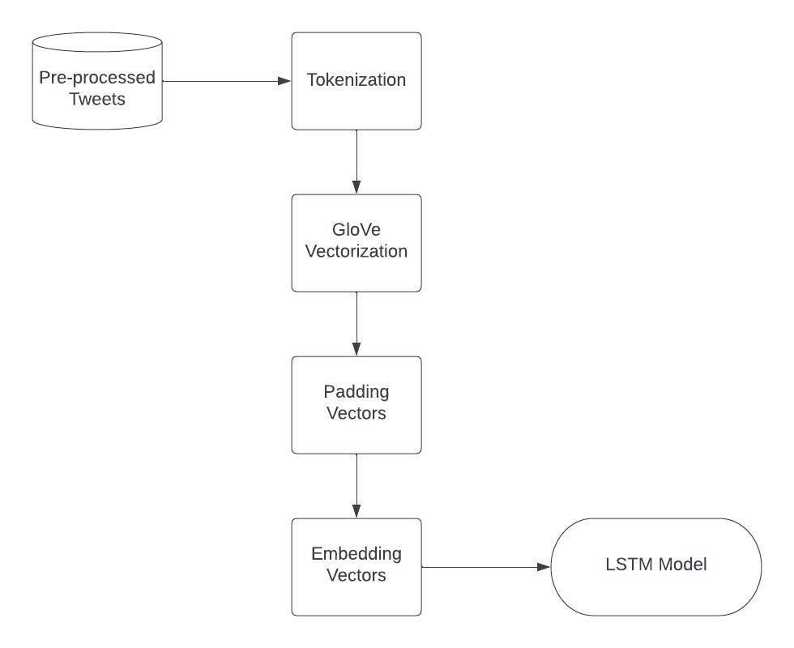
Functional Architecture of Module II

Slide 15
Module III - Building model (LSTM)
Input:processed feature vectors of tweet data
Output:a model that predicts the suicidality of each tweets and assigns a degree of suicidal ideation to the user profile basaed on the level of their suicidality.
Description:The LSTM model , after beginning with an accuracy of 96%, achieved a validation accuracy of 91% during the course of an operating period consisting of 16 epochs.With the use of cross-entropy measurements, the validation loss was reduced to a value as low as 0.22, which is a considerable improvement when compared with the initial value of 0.37.

Slide 16
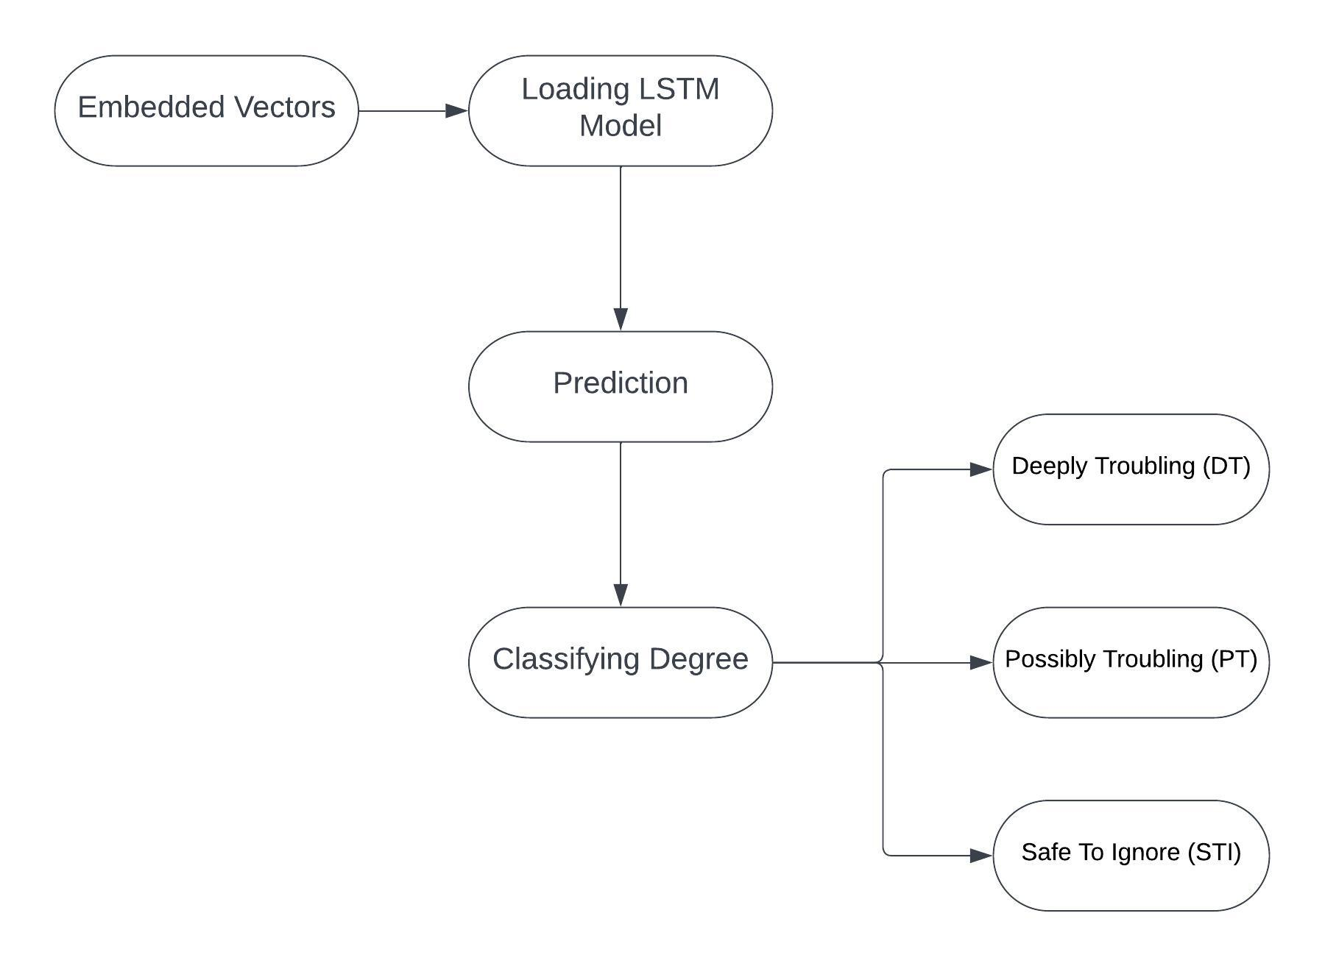
Functional Architecture of Module III

Slide 17
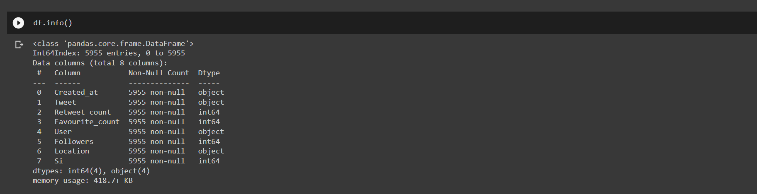
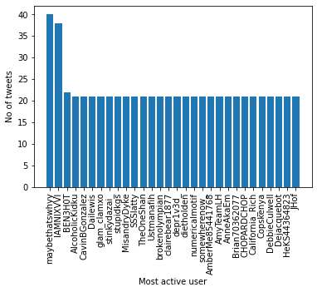
Implementation
Dataset information: Top 30 most active users with more than 17 tweets

Slide 18
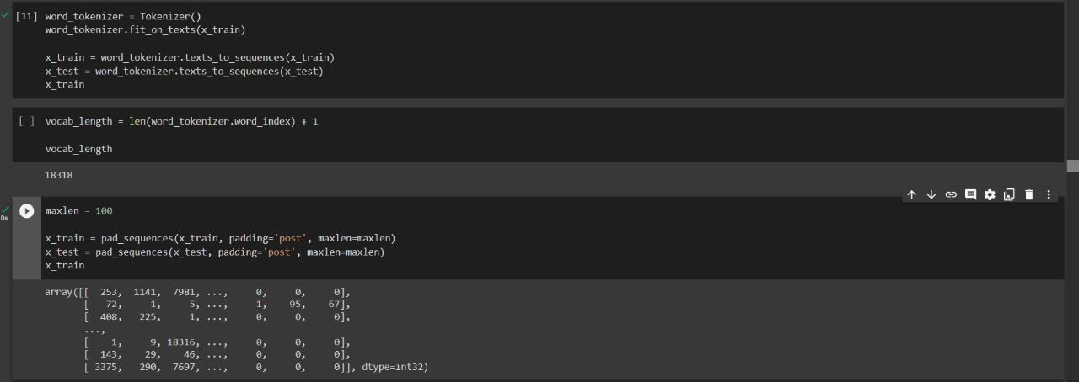
Implementation

Slide 19
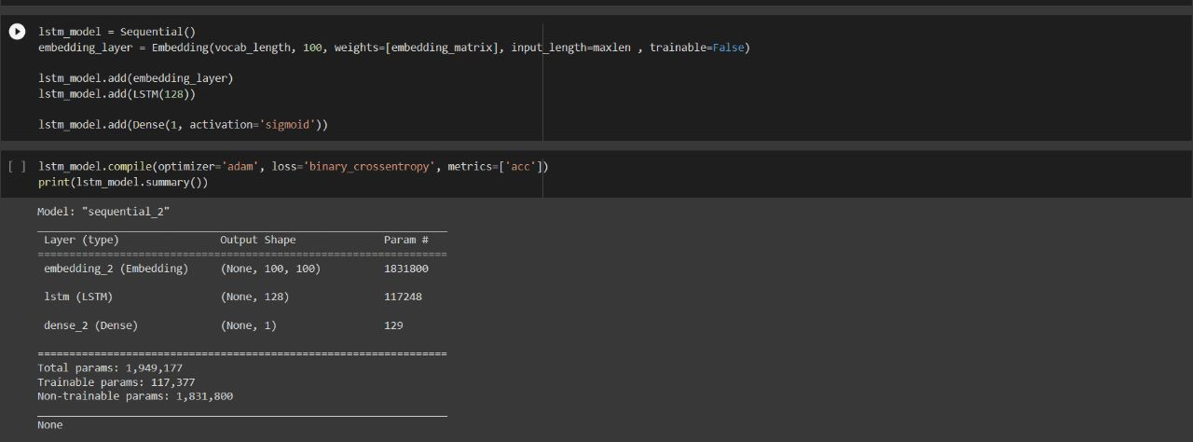
Implementation

Slide 20
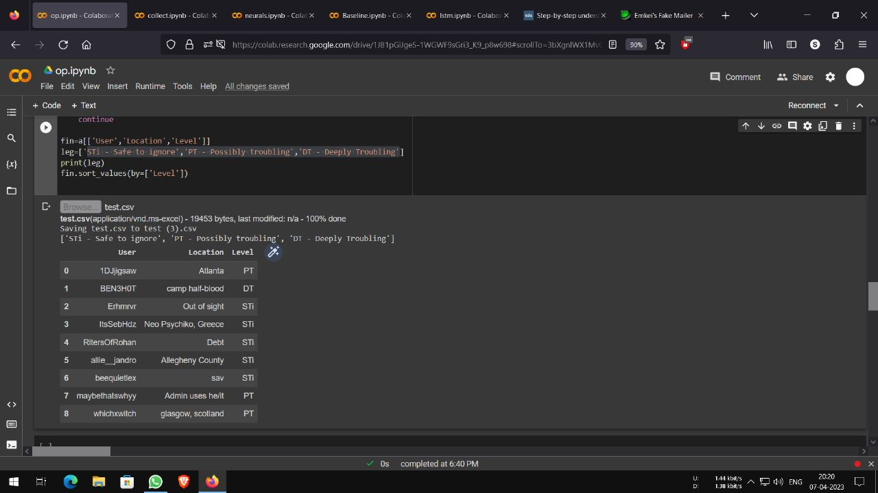
Implementation

Slide 21
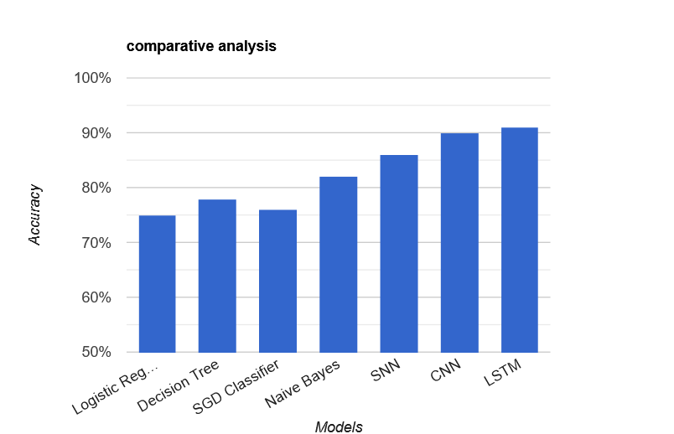
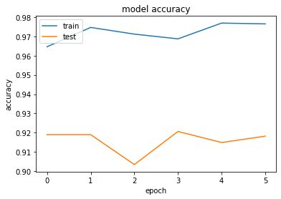
Performance Evaluation
Comparative analysis of the different models and their accuracy:

Slide 22
Test Cases
Test Case | Actual Result | Expected Result | Pass/Fail
Detection of suicidal tweets from a set | True positives and false positives | High accuracy and recall | Pass
Detection of non suicidal tweets from a set | True negatives and false negatives | High accuracy and recall | Pass
Displaying the degree of user profile | Level of user profile displayed | Level of user profile displayed | Pass
Output is perfectly displayed if all the fields are selected | Degree is displayed | Degree is displayed | Pass
It displays the following if any one of the files is left empty | It displays the following if any one of the files is left empty | Please enter the values and do not leave anything empty | Pass

Slide 23
System Requirements
Software Requirements:
Operating System : Windows 10 or later
Tool : Anaconda with Jupyter Notebook
Hardware Requirements:
Processor : Intel i3
Hard disk : minimum 10 GB
RAM : minimum 4 GB
Technology Used:
Python

Slide 24
LIST OF PUBLICATIONS
1. Eleventh International Conference On Contemporary Engineering And Technology May 1st - 2nd, 2023 Chennai, India.
2. https://sifisheriessciences.com/journal/index.php/journal/article/view/1507/1543 - Journal of Survey in Fisheries Science.

Slide 25
References
[1] Elayan, Suzanne, Martin Sykora, Ketan Shankardass, Colin Robertson, Rob Feick, Krystelle Shaughnessy, Lawrence Haydn, and Tom Jackson. "The stresscapes ontology system: detecting and measuring stress on social media." In 7th European Conference on Social Media ECSM 2020, pp. 74-82. 2020.
[2] Kumar, Mrinal, Mark Dredze, Glen Coppersmith, and Munmun De Choudhury. "Detecting changes in suicide content manifested in social media following celebrity suicides." In Proceedings of the 26th ACM conference on Hypertext & Social Media, pp. 85-94. 2015.
[3] Carlyle, Kellie E., Jeanine PD Guidry, Kofoworola Williams, Ariella Tabaac, and Paul B. Perrin. "Suicide conversations on Instagram™: contagion or caring?." Journal of Communication in Healthcare 11, no. 1 (2018): 12-18.
[4] Tadesse, Michael Mesfin, Hongfei Lin, Bo Xu, and Liang Yang. "Detection of suicide ideation in social media forums using deep learning." Algorithms 13, no. 1 (2019): 7.
[5]Wang, Jen, Martin Plöderl, Michael Häusermann, and Mitchell G. Weiss. "Understanding suicide attempts among gay men from their self-perceived causes." The Journal of nervous and mental disease 203, no. 7 (2015): 499-506.
[6] Jashinsky, Jared, Scott H. Burton, Carl L. Hanson, Josh West, Christophe Giraud-Carrier, Michael D. Barnes, and Trenton Argyle. "Tracking suicide risk factors through Twitter in the US." Crisis (2014).
[7] Sueki, Hajime, and Jiro Ito. "Suicide prevention through online gatekeeping using search advertising techniques." Crisis (2015).
[8] De Choudhury, Munmun, and Emre Kiciman. "The language of social support in social media and its effect on suicidal ideation risk." In Proceedings of the international AAAI conference on web and social media, vol. 11, no. 1, pp. 32-41. 2017.
[9] Naslund, John A., Ameya Bondre, John Torous, and Kelly A. Aschbrenner. "Social media and mental health: benefits, risks, and opportunities for research and practice." Journal of technology in behavioral science 5 (2020): 245-257.
[10] Gruebner, Oliver, Martin Sykora, Sarah R. Lowe, Ketan Shankardass, Sandro Galea, and S. V. Subramanian. "Big data opportunities for social behavioral and mental health research." Social science & medicine (1982) 189 (2017): 167-169.

Slide 26
References
[11] de Oliveira, Adonias C., Evandro JS Diniz, Silmar Teixeira, and Ariel S. Teles. "How can machine learning identify suicidal ideation from user's texts? Towards the explanation of the Boamente system." Procedia Computer Science 206 (2022): 141-150.
[12] Katchapakirin, Kantinee, Konlakorn Wongpatikaseree, Panida Yomaboot, and Yongyos Kaewpitakkun. "Facebook social media for depression detection in the Thai community." In 2018 15th international joint conference on computer science and software engineering (jcsse), pp. 1-6. IEEE, 2018.
[13] Renjith, Shini, Annie Abraham, Surya B. Jyothi, Lekshmi Chandran, and Jincy Thomson. "An ensemble deep learning technique for detecting suicidal ideation from posts in social media platforms." Journal of King Saud University-Computer and Information Sciences 34, no. 10 (2022): 9564-9575.
[14] Lekkas, Damien, Robert J. Klein, and Nicholas C. Jacobson. "Predicting acute suicidal ideation on Instagram using ensemble machine learning models." Internet Interventions 25 (2021): 100424.
[15]Haque, Farsheed, Ragib Un Nur, Shaeekh Al Jahan, Zarar Mahmud, and Faisal Muhammad Shah. "A transformer based approach to detect suicidal ideation using pre-trained language models." In 2020 23rd international conference on computer and information technology (ICCIT), pp. 1-5. IEEE, 2020.
[16] Shah, Faisal Muhammad, Farsheed Haque, Ragib Un Nur, Shaeekh Al Jahan, and Zarar Mamud. "A hybridized feature extraction approach to suicidal ideation detection from social media post." In 2020 IEEE Region 10 Symposium (TENSYMP), pp. 985-988. IEEE, 2020.
[17] Chadha, Akshma, and Baijnath Kaushik. "Machine learning based dataset for finding suicidal ideation on twitter." In 2021 Third International Conference on Intelligent Communication Technologies and Virtual Mobile Networks (ICICV), pp. 823-828. IEEE, 2021.
[18] Cao, Lei, Huijun Zhang, and Ling Feng. "Building and using personal knowledge graph to improve suicidal ideation detection on social media." IEEE Transactions on Multimedia 24 (2020): 87-102.
[19] Mittal, Aayush, Abhishek Goyal, and Mohit Mittal. "Data preprocessing based connecting suicidal and help-seeking behaviours." In 2021 5th International Conference on Computing Methodologies and Communication (ICCMC), pp. 1824-1830. IEEE, 2021.
[20] Chatterjee, Moumita, Piyush Kumar, Poulomi Samanta, and Dhrubasish Sarkar. "Suicide ideation detection from online social media: A multi-modal feature based technique." International Journal of Information Management Data Insights 2, no. 2 (2022): 100103.

Slide 27


